Slide 1
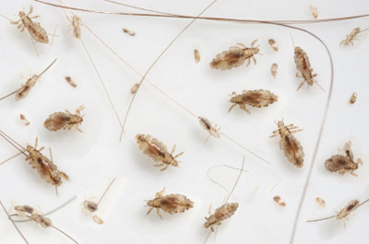
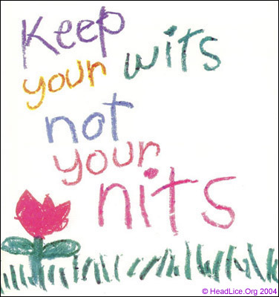
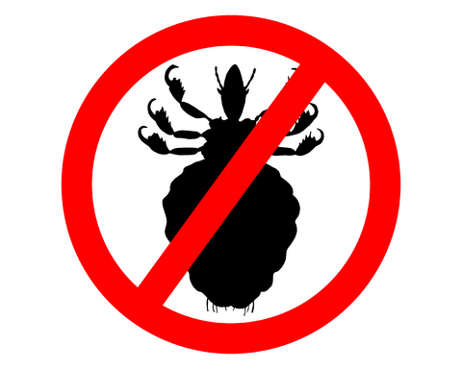
Head Lice
Biology and Management
Shujuan (Lucy) Li
University of Arizona

Slide 2
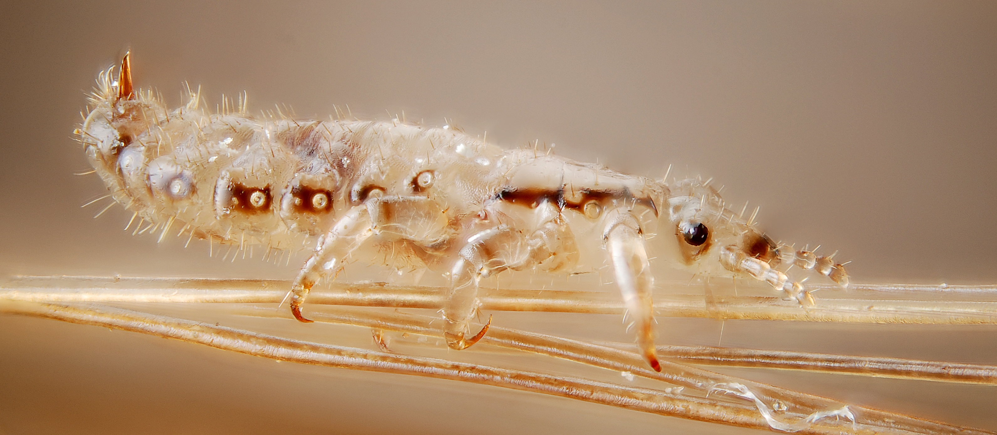
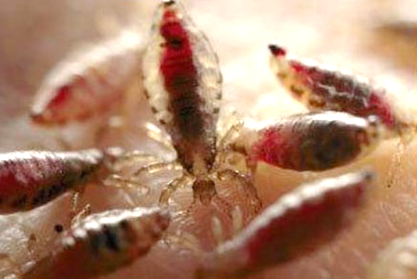
Head Lice
Blood feeding ectoparasites associated with the scalp.
More commonly found in school age students (3-11 years old) and girls.
Transfer can occur
due to
  Physical head-to-
  head contact.
  Slumber parties!

Slide 3

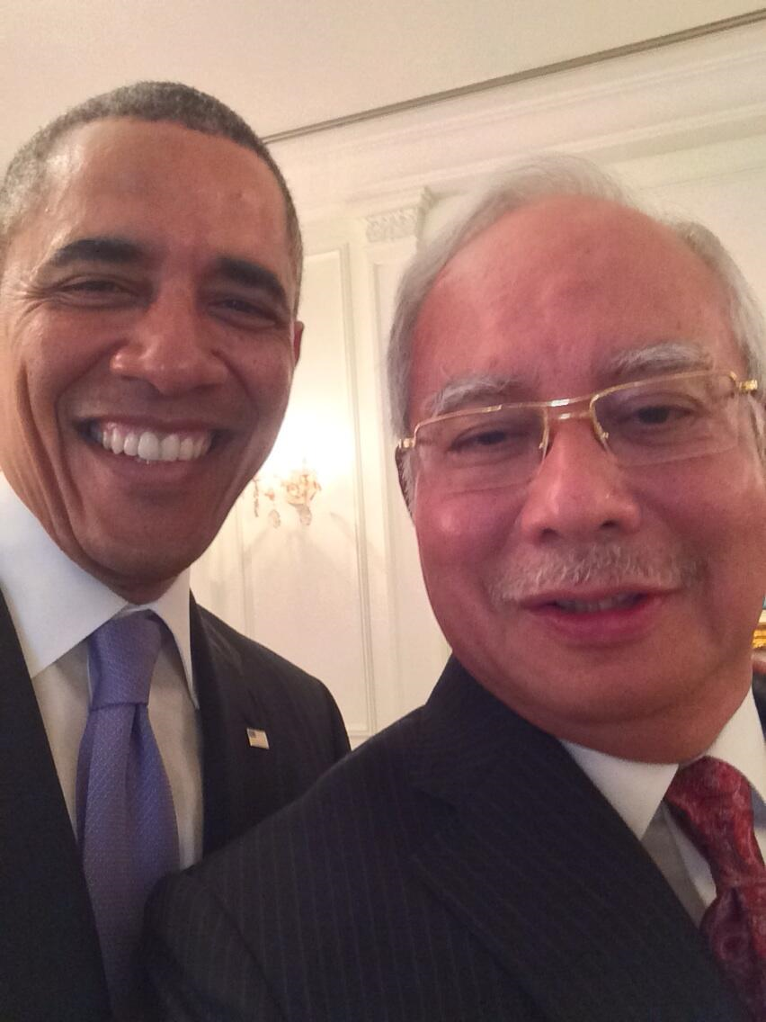

1.
What was really behind the “selfie”?
More than a million selfies are taken each day, according to research by TechInfographics.com.
The Holy Father
Pope Francis
President Obama with
Malaysian Prime Minister Najib Razak
Notes:
Preschool and elementary age: (3-11 years old)

Slide 4
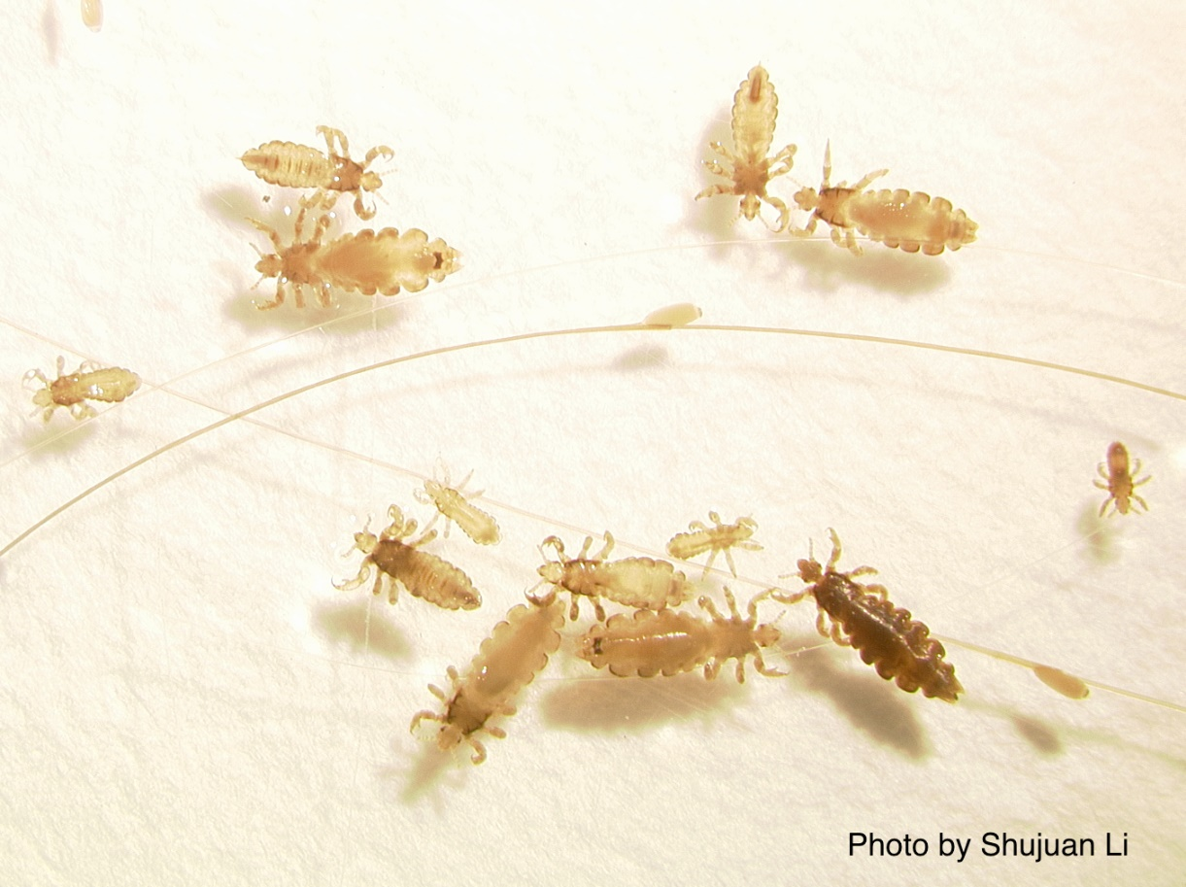
1.
What was really behind the “selfie”?
More than a million selfies are taken each day, according to research by TechInfographics.com.
The Holy Father
Pope Francis
President Obama with
Malaysian Prime Minister Najib Razak
Image: Shujuan (Lucy)Li
Notes:
Preschool and elementary age: (3-11 years old)

Slide 5
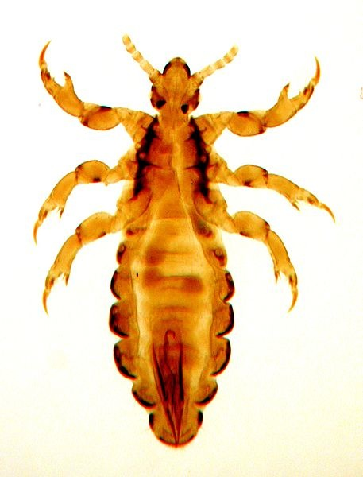
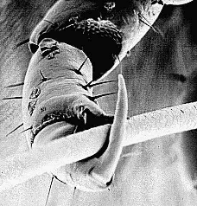
Size of a sesame seed (2-3 mm long).
Tan in color.
Crawl rapidly using claw-like legs across the scalp.
Die off scalp within 2 days.
1% of students affected.
Schools are not good transition zones.
$1 billion US cost.

Slide 6
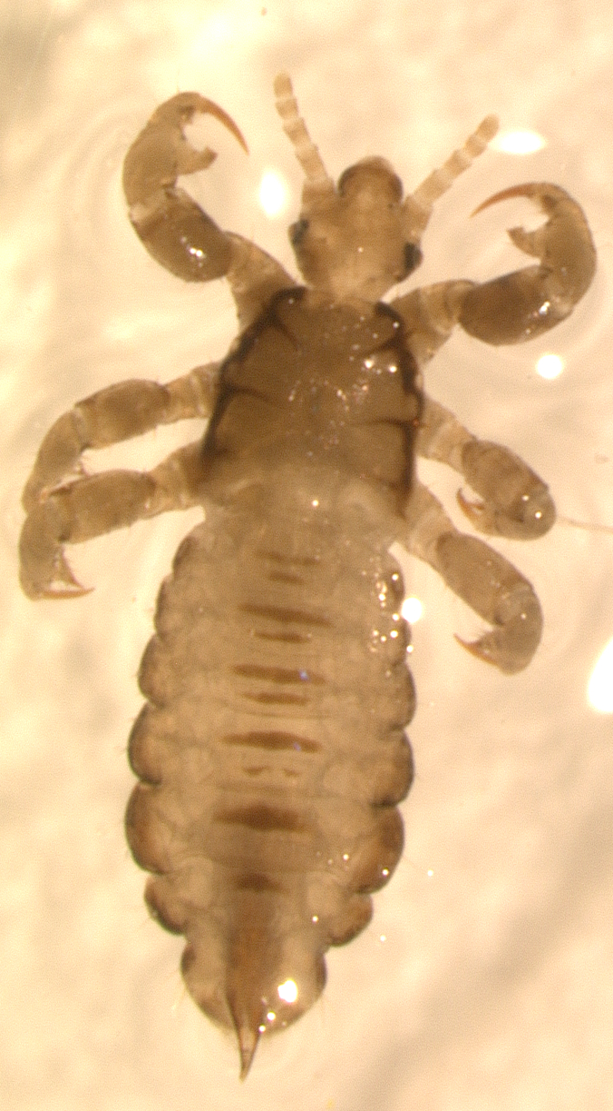
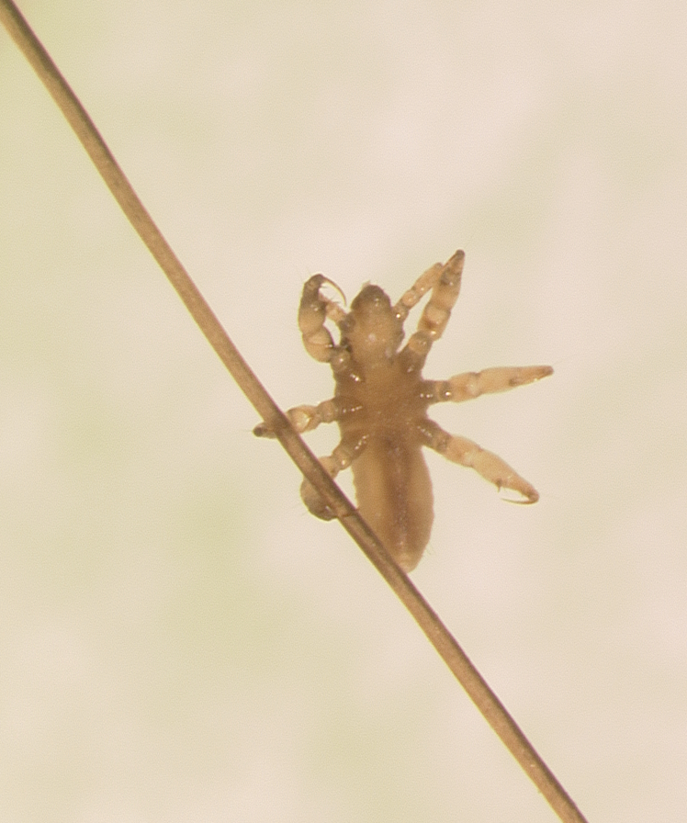
Images: Shujuan (Lucy)Li

Slide 7
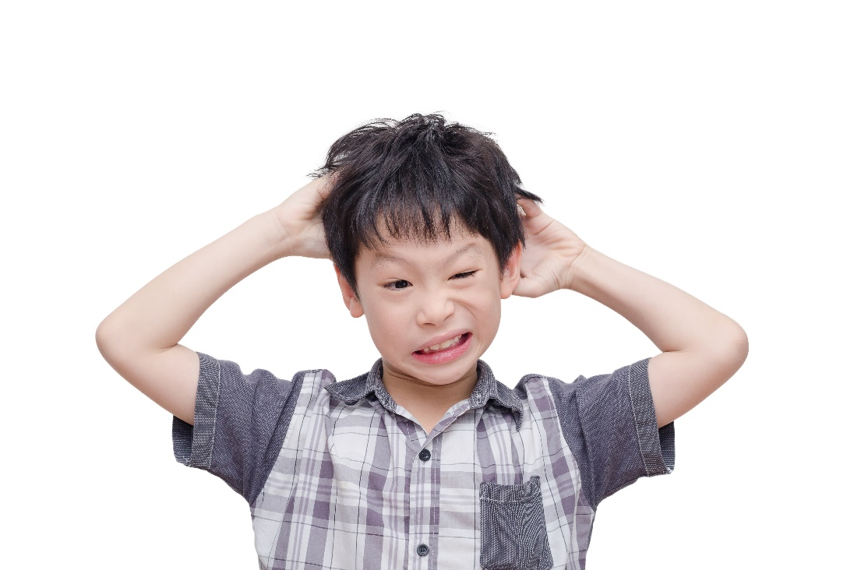
1.
Lice feed many times each day.
Cause itching and sleeplessness.
Scratching may lead to secondary skin infections.
Do not transmit disease
causing pathogens.
Head lice feeding causes itching

Slide 8
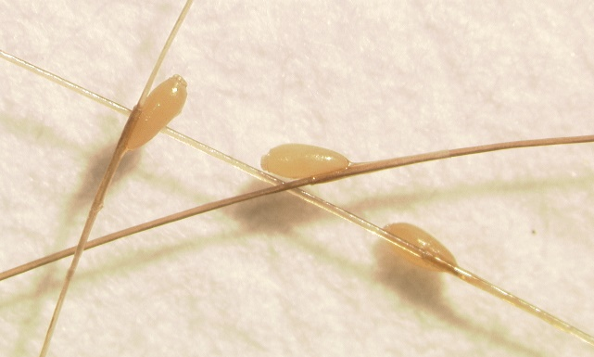
Females attach nits to hair 1 mm from the scalp.
Nits need body warmth.
Unhatched eggs are not obvious.
Nits are easily seen at the hairline.
Nits >1cm – hatched.
Head lice nits –
Shujuan Li, University of Arizona

Slide 9
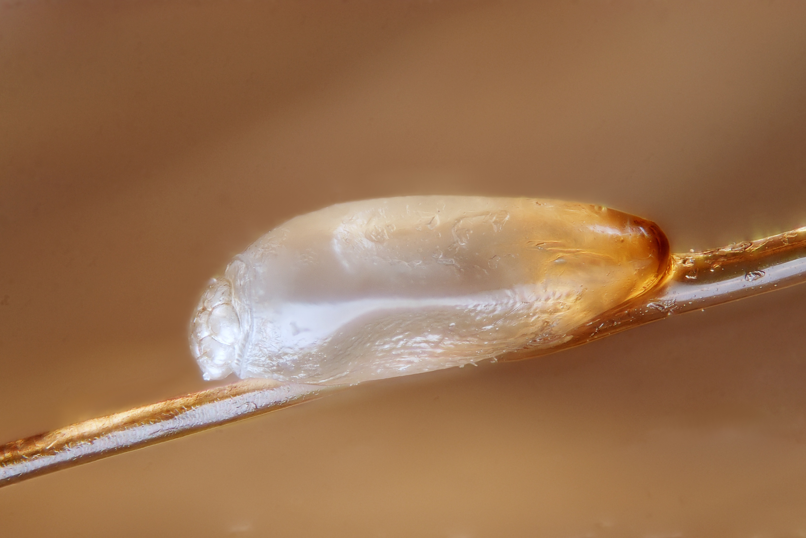
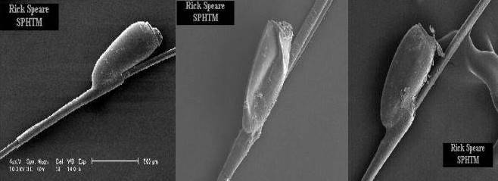
Eggs that have died or hatched, remain firmly attached to the hair; but will never again produce another louse.
Lice eggs have curved walls and will pop when squeezed
Dead eggs have collapsed sides
Hatched eggs have a flat top in profile

Slide 10
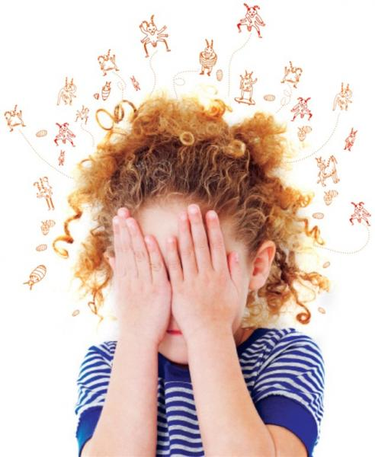

1.
Finding nits alone is not a reason to treat.
Discourage head-to-head contact.
Discourage pillow sharing.
Treatment is recommended only for individuals found with live lice.

Slide 11
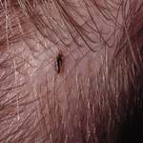
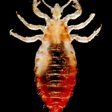
Lice feed by injecting small amounts of saliva and taking tiny amounts of blood from the scalp every few hours. This saliva may create an itchy irritation.
With a first case of head lice, itching may not develop for 4 to 6 weeks, because it takes time to develop a sensitivity to louse saliva.
If not treated, life cycle may repeat itself every 3 weeks.

Slide 12
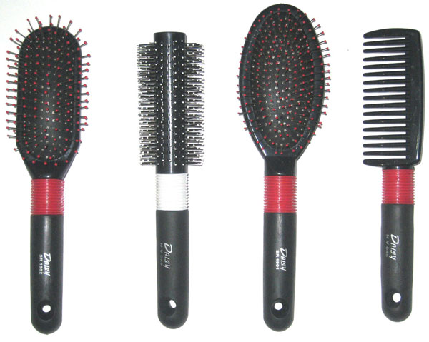
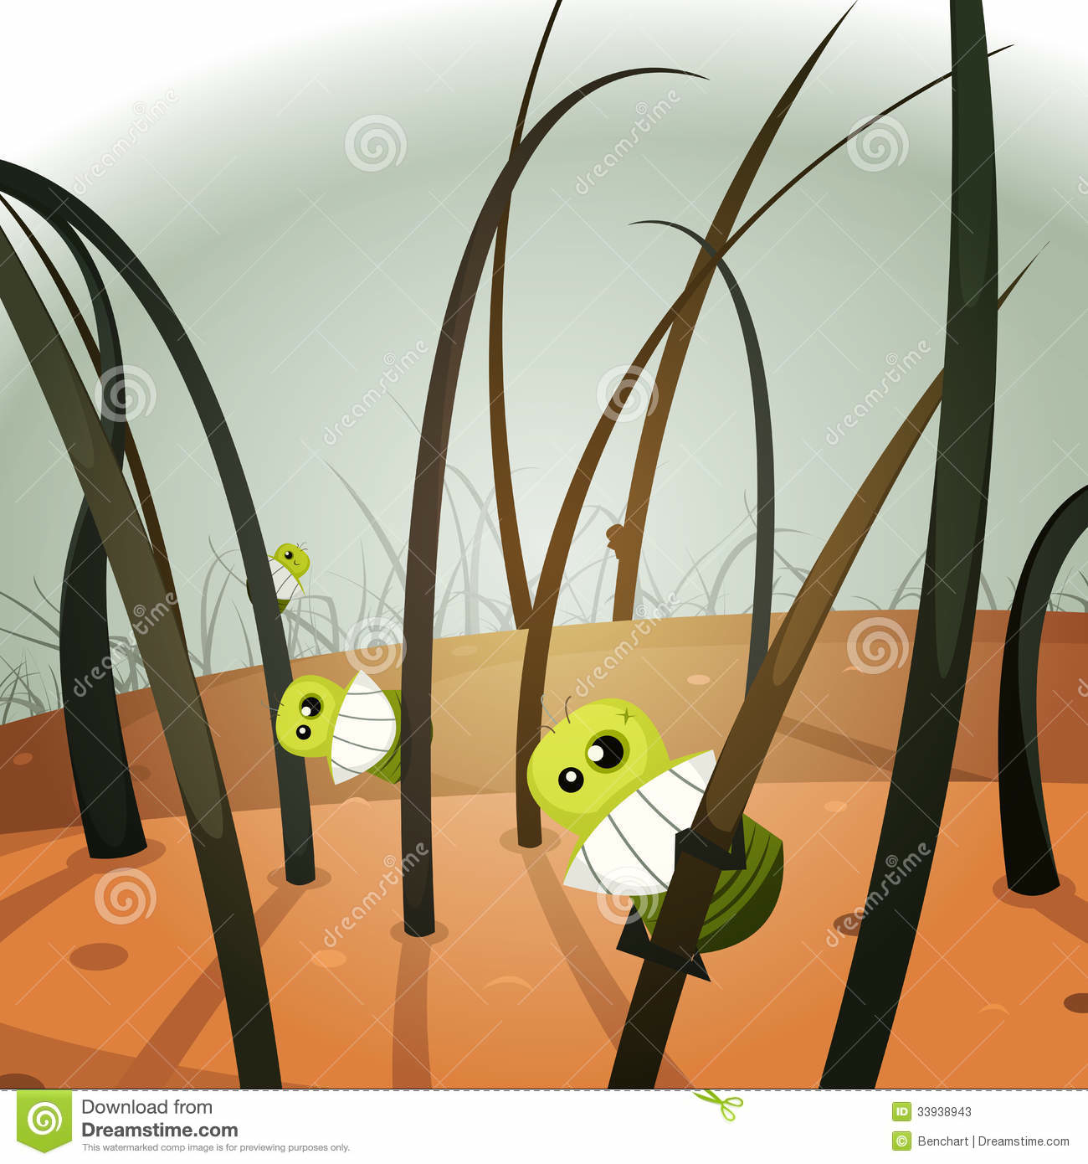
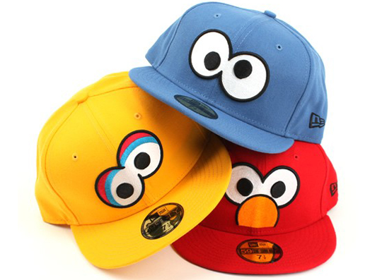
Transmission (Spread) of Head Lice
Head-to-head contact with an infested person and sleepovers are the BIG transfer risks.
Only LIVING LICE can transfer from one person to another.
The transmission from hats, combs, pillows, etc. is possible, but unlikely.
Nits cannot be passed onto someone else.

Slide 13

Checking for Head Lice
Periodic inspections for early detection of adult lice are far easier than dealing with advanced infestations.
During the early fall months (August to November) children should be inspected weekly by parents.
Prevention (home screening) is the best way to reduce the spread of lice infestation.

Slide 14
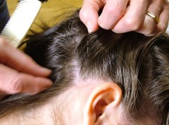
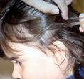
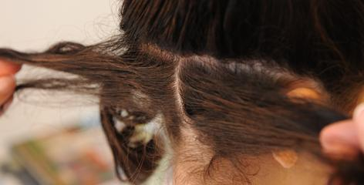
To confirm a case of head lice, you need to find live head lice.
Head lice move fast and are hard to see. They are usually found very close to the scalp, at the bottom of the neck and behind the ears.
To look for nits, part hair in small sections, moving from one side of the head to the other. Check carefully, looking close to the scalp.

Slide 15
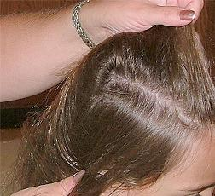
Look for nits near the scalp. Eggs more than ½ inch away from the scalp are nearly always hatched or dead and do not, by themselves, indicate an active infestation or a need for treatment.
If adults or lots of nits (more than 5 nits occurring in the area of a dime) are found, this is a call to action.
Also check everyone in the household, including adults.

Slide 16
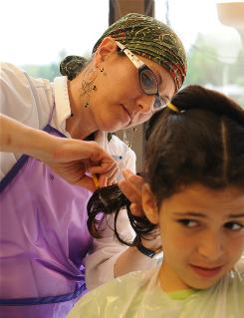
Confidentiality!
Ensure sensitivity surrounding the child’s feelings. Anyone can get lice and no one is immune (children or adults). Lack of cleanliness does not cause head lice (stigma).

Slide 17
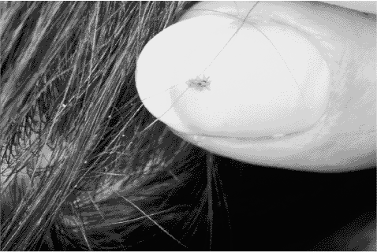
Found lice?
Treatment is recommended only for individuals found with live lice

Slide 18
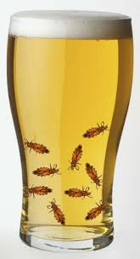
Pediculicides
Treatment of Head Lice
Chemical treatments
Natural products
  mayonnaise, petroleum jelly, vinegar, olive oil, tea tree oil, or aromatherapy
Alcohol
  benzyl alcohol
Never use gasoline or spray insecticides to treat lice.
Notes:
Today, insecticides used for the treatment of head lice include organochlorines (lindane), organophosphates (malathion), carbamates (carbaryl), pyrethrins (pyrethrum), and pyrethroids (permethrin, phenothrin, bio-allethrin).
The only agents approved by the FDA for treatment of pediculosis are lindane and malathion.[2]
Laboratory and clinical studies found that many of the pediculicides in the market are either not fully effective or are ineffective when they are used according to the instructions.[3][4][5][6]
Pediculicides may rapidly lose their efficacy because of the development of resistance. Resistance of head lice to insecticides such as lindane, malathion, phenothrin and permethrin has been reported.[7][8][9]

Slide 19
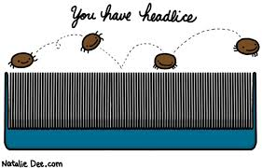
Lice shampoos (Pediculicides)
  Contain insecticides (Pyrethrins, Permethrin, Lindane, Malathion, etc)
  Be cautious when applying treatments
  Never apply treatments to children in the bath or shower
  Always read and follow label directions completely and carefully
Notes:
Head lice shampoos contain insecticides and if they are not used properly they can be hazardous. When using a head louse shampoo, minimize body exposure by confining the insecticide to the head hair. Wash the infested person's hair in a basin or sink so insecticide residues do not reach other parts of the body. Never apply treatments to children in the bath or shower! The person applying the treatment should wear rubber gloves. Never apply an insecticide to anyone who has open cuts, scratches, or inflammations, and never use these materials on infants without consulting a doctor. In all cases, follow label directions completely and carefully.

Slide 20
Lice shampoos
  Susceptible lice should die within 10 to 30 min after treatment
  A second treatment may be required in 10 to 14 days
  Resistance may be occurring
  Switch to a different kind of product that does not contain the same active ingredient
Notes:
Head lice shampoos contain insecticides and if they are not used properly they can be hazardous. When using a head louse shampoo, minimize body exposure by confining the insecticide to the head hair. Wash the infested person's hair in a basin or sink so insecticide residues do not reach other parts of the body. Never apply treatments to children in the bath or shower! The person applying the treatment should wear rubber gloves. Never apply an insecticide to anyone who has open cuts, scratches, or inflammations, and never use these materials on infants without consulting a doctor. In all cases, follow label directions completely and carefully.

Slide 21
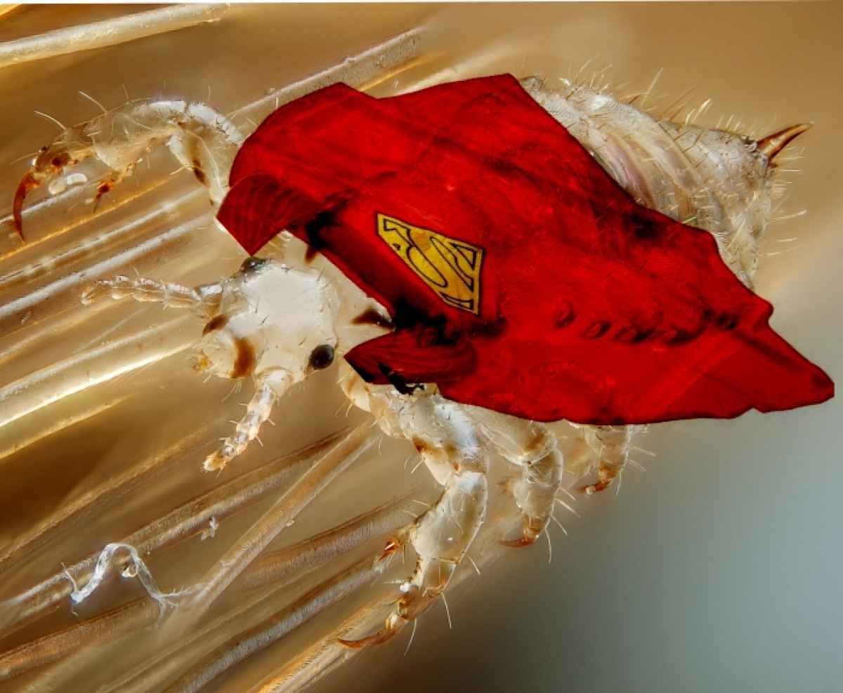
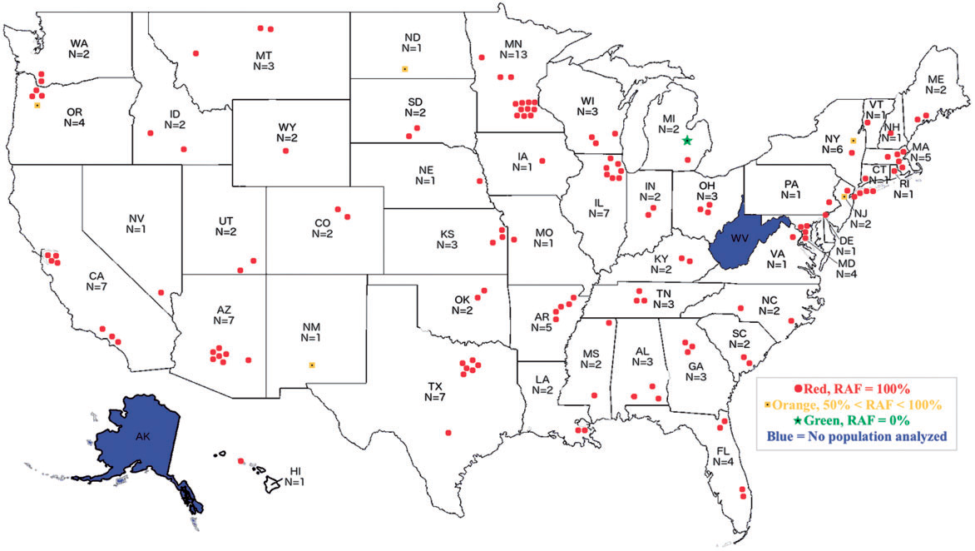
Head lice are resistant to OTC pediculicides

Slide 22
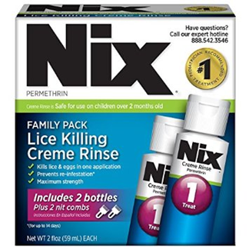
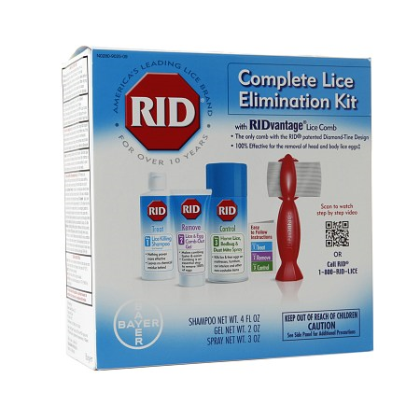
In Arizona, head lice are highly resistant to OTC pediculicides
Product names mentioned are registered trademarks. Any products, services, or organizations that are mentioned, shown, or indirectly implied in this publication do not imply endorsement by The University of Arizona.

Slide 23
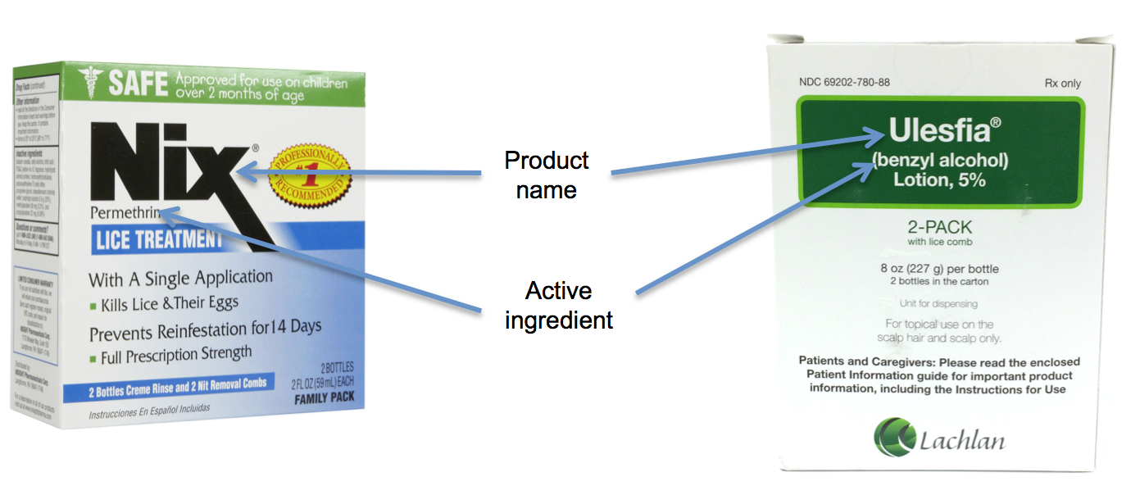
Product names mentioned are registered trademarks. Any products, services, or organizations that are mentioned, shown, or indirectly implied in this publication do not imply endorsement by The University of Arizona.

Slide 24
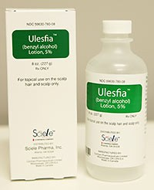
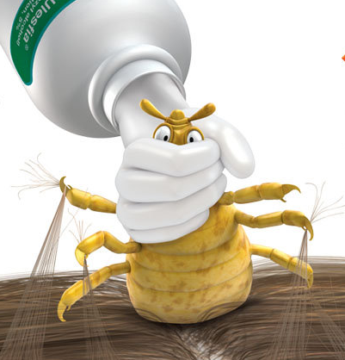
Prescription lice treatment options
  Resistant lice may need prescription treatment.
  Benzyl alcohol (Ulesfia, 5% solution): non-neurotoxic, highly effective lotion.
  Kills the live lice.
  Not ovicidal (doesn’t kill eggs).
  2 treatments are necessary.
  Consult your doctors before using it.
  No resistance reported.
Product names mentioned are registered trademarks. Any products, services, or organizations that are mentioned, shown, or indirectly implied in this publication do not imply endorsement by The University of Arizona.
Notes:
If live lice persist following treatment with over the counter products, parents should discuss with doctors.
Ulesfia® (benzyl alcohol)is a non-neurotoxic,highly effective lotion used for the topical treatment of head lice infestation in patients 6 months of age and older. Ulesfia® like most treatments is not ovicidal(does not kill the eggs), so 2 treatments are necessary. This product is a prescription only treatment but is currently one of the most effective products with fewer side-effects.
With pyrethrin and permethrin shampoos, lice should die within 10 to 30 minutes after treatment. If you find live lice after 30 minutes, resistance may be occurring and you should discontinue use of that product. Switch to a different kind of product e.g. benzyl alcohol Ulesvia prescription). Never resort to dangerous practices such as applying other insecticides, or materials such as kerosene!

Slide 25
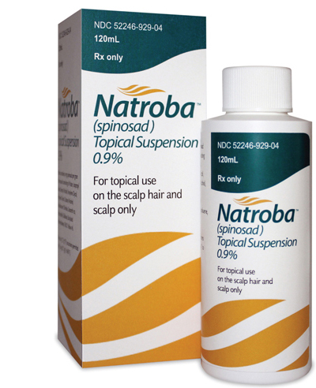
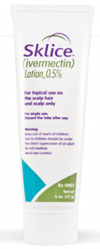
  Natroba Topical Suspension (spinosad 0.9% + benzyl alcohol)
    Does not require nit combing.
    Not use on newborns and infants younger than 6 months.
  Sklice Lotion (ivermectin 0.5%)
    On hair and scalp only.
    FDA approved as a 10-min head lice treatment for people older than 6 months.
    Adult supervision is required.
    Avoid contact with eyes.
  2 treatments are commonly needed.
Product names mentioned are registered trademarks. Any products, services, or organizations that are mentioned, shown, or indirectly implied in this publication do not imply endorsement by The University of Arizona.

Slide 26
Prescription treatments for head lice
Active ingredient | Mode of action | Product example
Ivermectin | Disrupts nervous system | Stromectol and generics
 |  | Sklice
Spinosad* | Disrupts nervous system | Natroba™
Benzyl alcohol* | Suffocates lice | Ulesfia
Pyrethroid-based^{1,2} | Disrupts nervous system | Elimite, Permethrin, etc.
Malathion² | Disrupts nervous system | Ovide and generics
Lindane² | Disrupts nervous system | Kwell
Product names mentioned are registered trademarks. Any products, services, or organizations that are mentioned, shown, or indirectly implied in this publication do not imply endorsement by The University of Arizona.

Slide 27

Alternative treatments
  Soap shampoos containing coconut or olive oils.
  Begin with four shampoo applications, each about 3 days apart.
  Kills newly-hatched nymphs.
  Kill lice mechanically: Hair drying and brushing.
Home remedies such as mayonnaise, petroleum jelly, olive oil, tea tree oil, vinegar, or aromatherapy have been shown to make it hard for lice to breath. No evidence suggests it effectively kills all nits or lice.
Standard hair conditioner is as effective.
Notes:
Home remedies such as mayonnaise, petroleum jelly, olive oil, tea tree oil, vinegar, or aromatherapy have been shown to make it hard for lice to breath. No evidence suggests it effectively kills all nits or lice.
If you want to avoid insecticides entirely, try using soap shampoos that contain coconut or olive oils. Begin with four shampoo applications, each about 3 days apart. Each successive shampooing kills newly- hatched nymphs. Hair drying and brushing is a very effective way of killing lice mechanically.
None of the Natural products have good data to support claims, but any time you mess with an infested head you kill lice. The MOST beneficial low-impact things to mechanically kill lice:
1) Hairdryer
2) Brushing dry hair
3) Nitpicking
4) Regular hair conditioners

Slide 28
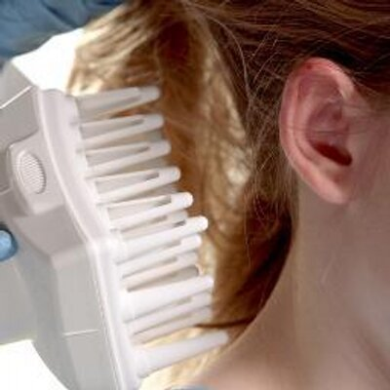
Non-Prescription treatments for head lice
Active ingredient or strategy | Mode of action | Product example
Dimethicone (dimeticone) | Disruption of water homeostasis and suffocation | Dimethicone LiceMD gel, Rapunzel’s Lice neutralizer, Hedrin 4% Dimeticone Head Lice Lotion, KaPOW! Lice Attack Solution
Natrum Muriaticum (sodium chloride) (in benzyl alcohol*) | Dehydrates or suffocates lice | Vamousse Lice Treatment, Licefreee!
Pyrethroid-based¹ | Disrupts nervous system | Nix, Pronto, Rid, etc.
Enzymes (vegetable extracts) | Helps to dissolve or soften the glue that attaches the nit to the hair shaft | LiceLogic, Lice B Gone, Safe Solutions Lice R Gone®
Heat | Desiccates lice and nits | AirAllé®

Slide 29
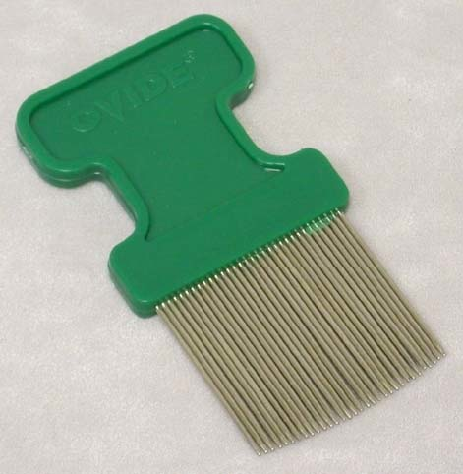
Manual Removal
None of the pediculicides are 100% ovicidal.
Manual removal of nits (especially the ones within 1 cm of the scalp) after treatment with any product is recommended.
Special, fine-toothed “nit combs” are needed (LiceMeisterTM combs).
Combing and brushing wet hair damages lice. Hair drying injures adults and nymphs.
Nit removal aids are designed to loosen the attachment of the nit to the hair shaft.
Product names mentioned are registered trademarks. Any products, services, or organizations that are mentioned, shown, or indirectly implied in this publication do not imply endorsement by The University of Arizona.

Slide 30
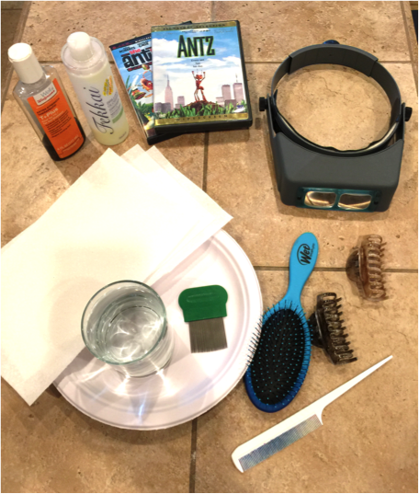
Vinegar or vinegar-based products (e.g. Clear Lice Egg Remover Gel) are applied to the hair for 3 minutes before combing out the nits. No clinical benefit has been demonstrated.
Combing is critical to control head lice.
Comb daily until no live lice are discovered (2 weeks).
Recheck in 2-3 weeks after you think they are gone.
Product names mentioned are registered trademarks. Any products, services, or organizations that are mentioned, shown, or indirectly implied in this publication do not imply endorsement by The University of Arizona.

Slide 31
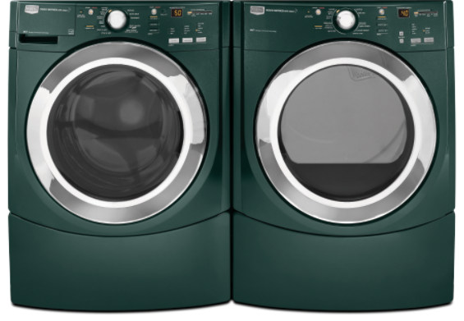
Home disinfection
Wash items in hot soapy water and dry in a hot dryer for 15 minutes.
Launder and dry on a high heat, 130 degree F.
Store items in plastic bags for 2 weeks.
Vacuum the surfaces where heads may have rested
(sofas, helmets, car seats, etc).
Notes:
Once an infestation is detected, all clothes should be washed in hot soapy water. Pillowcases, sheets, blankets and other bedding material should also be washed and placed in the clothes dryer on the "high heat" cycle to kill the lice and their eggs. Any non-washable items should be dry cleaned or sealed in plastic bags and placed in the freezer at 5 degreeF or lower for 10 hours or more (a good option for headphones). Vacuuming the home will remove shed hair that has nits attached. Remember if the lice are off the body for 48 hour they are all dead, so simply leaving things that cannot be laundered (very large stuffed animals, duvets, furniture etc.) in a bag or off-limits for 48 hours will do the trick.
Although head lice do not live long off the scalp; to avoid re-infection or transmission to other person it is recommended to clean all hats, combs/brushes, pillowcases, bed sheets, stuffed animals etc. Avoid the use of insecticide sprays.
Wash in hot water all bedding, towels and clothing that came into contact with the infected person's head, within 48 hours of starting treatment. Items such as combs, brushes, and head accessories may be treated by sealing in plastic bags for 2-4 weeks, boiling in water for 5 minutes or soaking in rubbing alcohol for 1 hour. Lice are a common childhood problem. Now you know how to tackle the treatment if it comes to your home.

Slide 32
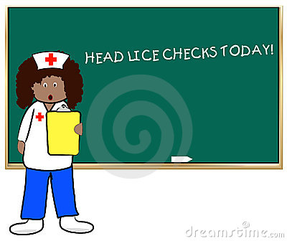
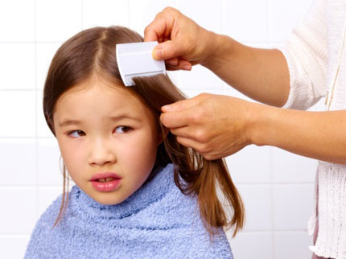
Check regularly
Daily head checks and nit removal until infestation is gone.
Followed by weekly head checks to detect re-infestation.
Continue weekly head checks of the whole family.

Slide 33
Hygiene and Sanitation
  Students with head lice should not be excluded from school.
  Transfer occurs through
  head-to-head contact.
  No-nit policies are pointless.
  Head-checks are valuable opportunities for the nurse to interact with students.

Slide 34
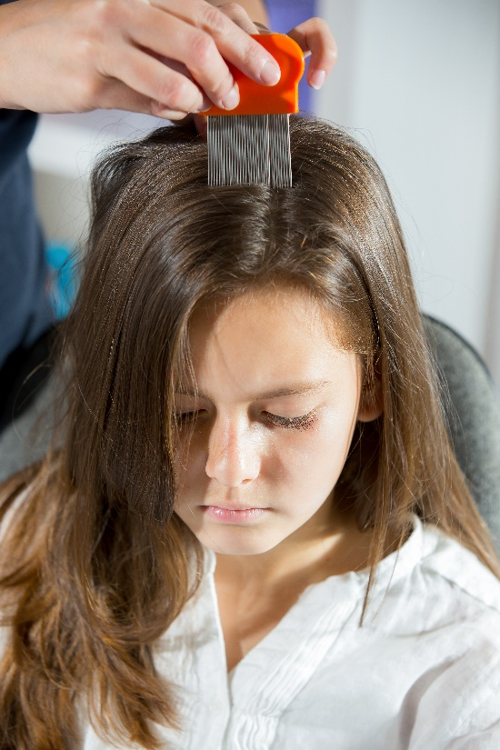
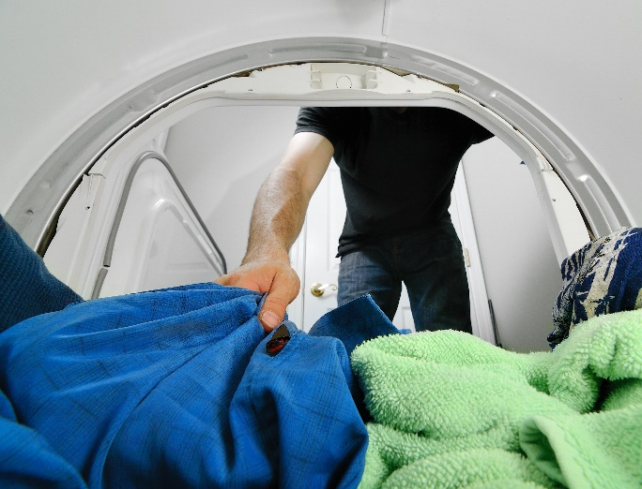
  Students with head lice should not share coats or bedding.
  Chronic infestations can be a sign of neglect.
  Clothes dryers kill lice.
  Lice die in <2 days off a host.
  Hard surface cleaning and
  vacuuming should be
  undertaken.
Nurse checking for head lice
Clothes dryers kill lice

Slide 35
Providing information to families on the diagnosis, treatment, and prevention of head lice is a good plan.
Parents and the school nurses should be encouraged to check their children’s heads for lice if the child is symptomatic.
Work with parents! Routine screening, early detection, accurate ID and thorough removal of lice and nits.
Children need to be educated about sharing hats, helmets, etc.

Slide 36
Classroom Management
No need to spray the classroom. Regular cleaning agents would work to control head lice.
Lice do not infest classrooms, carpets and chairs.
Space desks and chairs apart so that children are not sitting shoulder-to- shoulder.
Have children hang coats and hats separately.

Slide 37
Space children apart when standing or walking in lines.
During head lice outbreaks, minimize close contact games and sports, such as wrestling.
During outbreaks, minimize use of shared headgear and clothing. Always hand vacuum such headgear between users.
Provide head louse prevention education to children, such as not sharing combs, brushes, hats, headbands, or clothing.

Slide 38
Please Remember
Only living lice transfer from person to person.
Head lice don’t fly or jump.
They don’t transmit infectious disease.
Head lice can’t survive more than 48 hours away from the host.
Head lice can’t live within rugs, carpets, or school buses.
No need to exclude infested kids from school.
Work with parents! Routine screening, early detection, accurate ID and thorough removal of lice and nits.

Slide 39
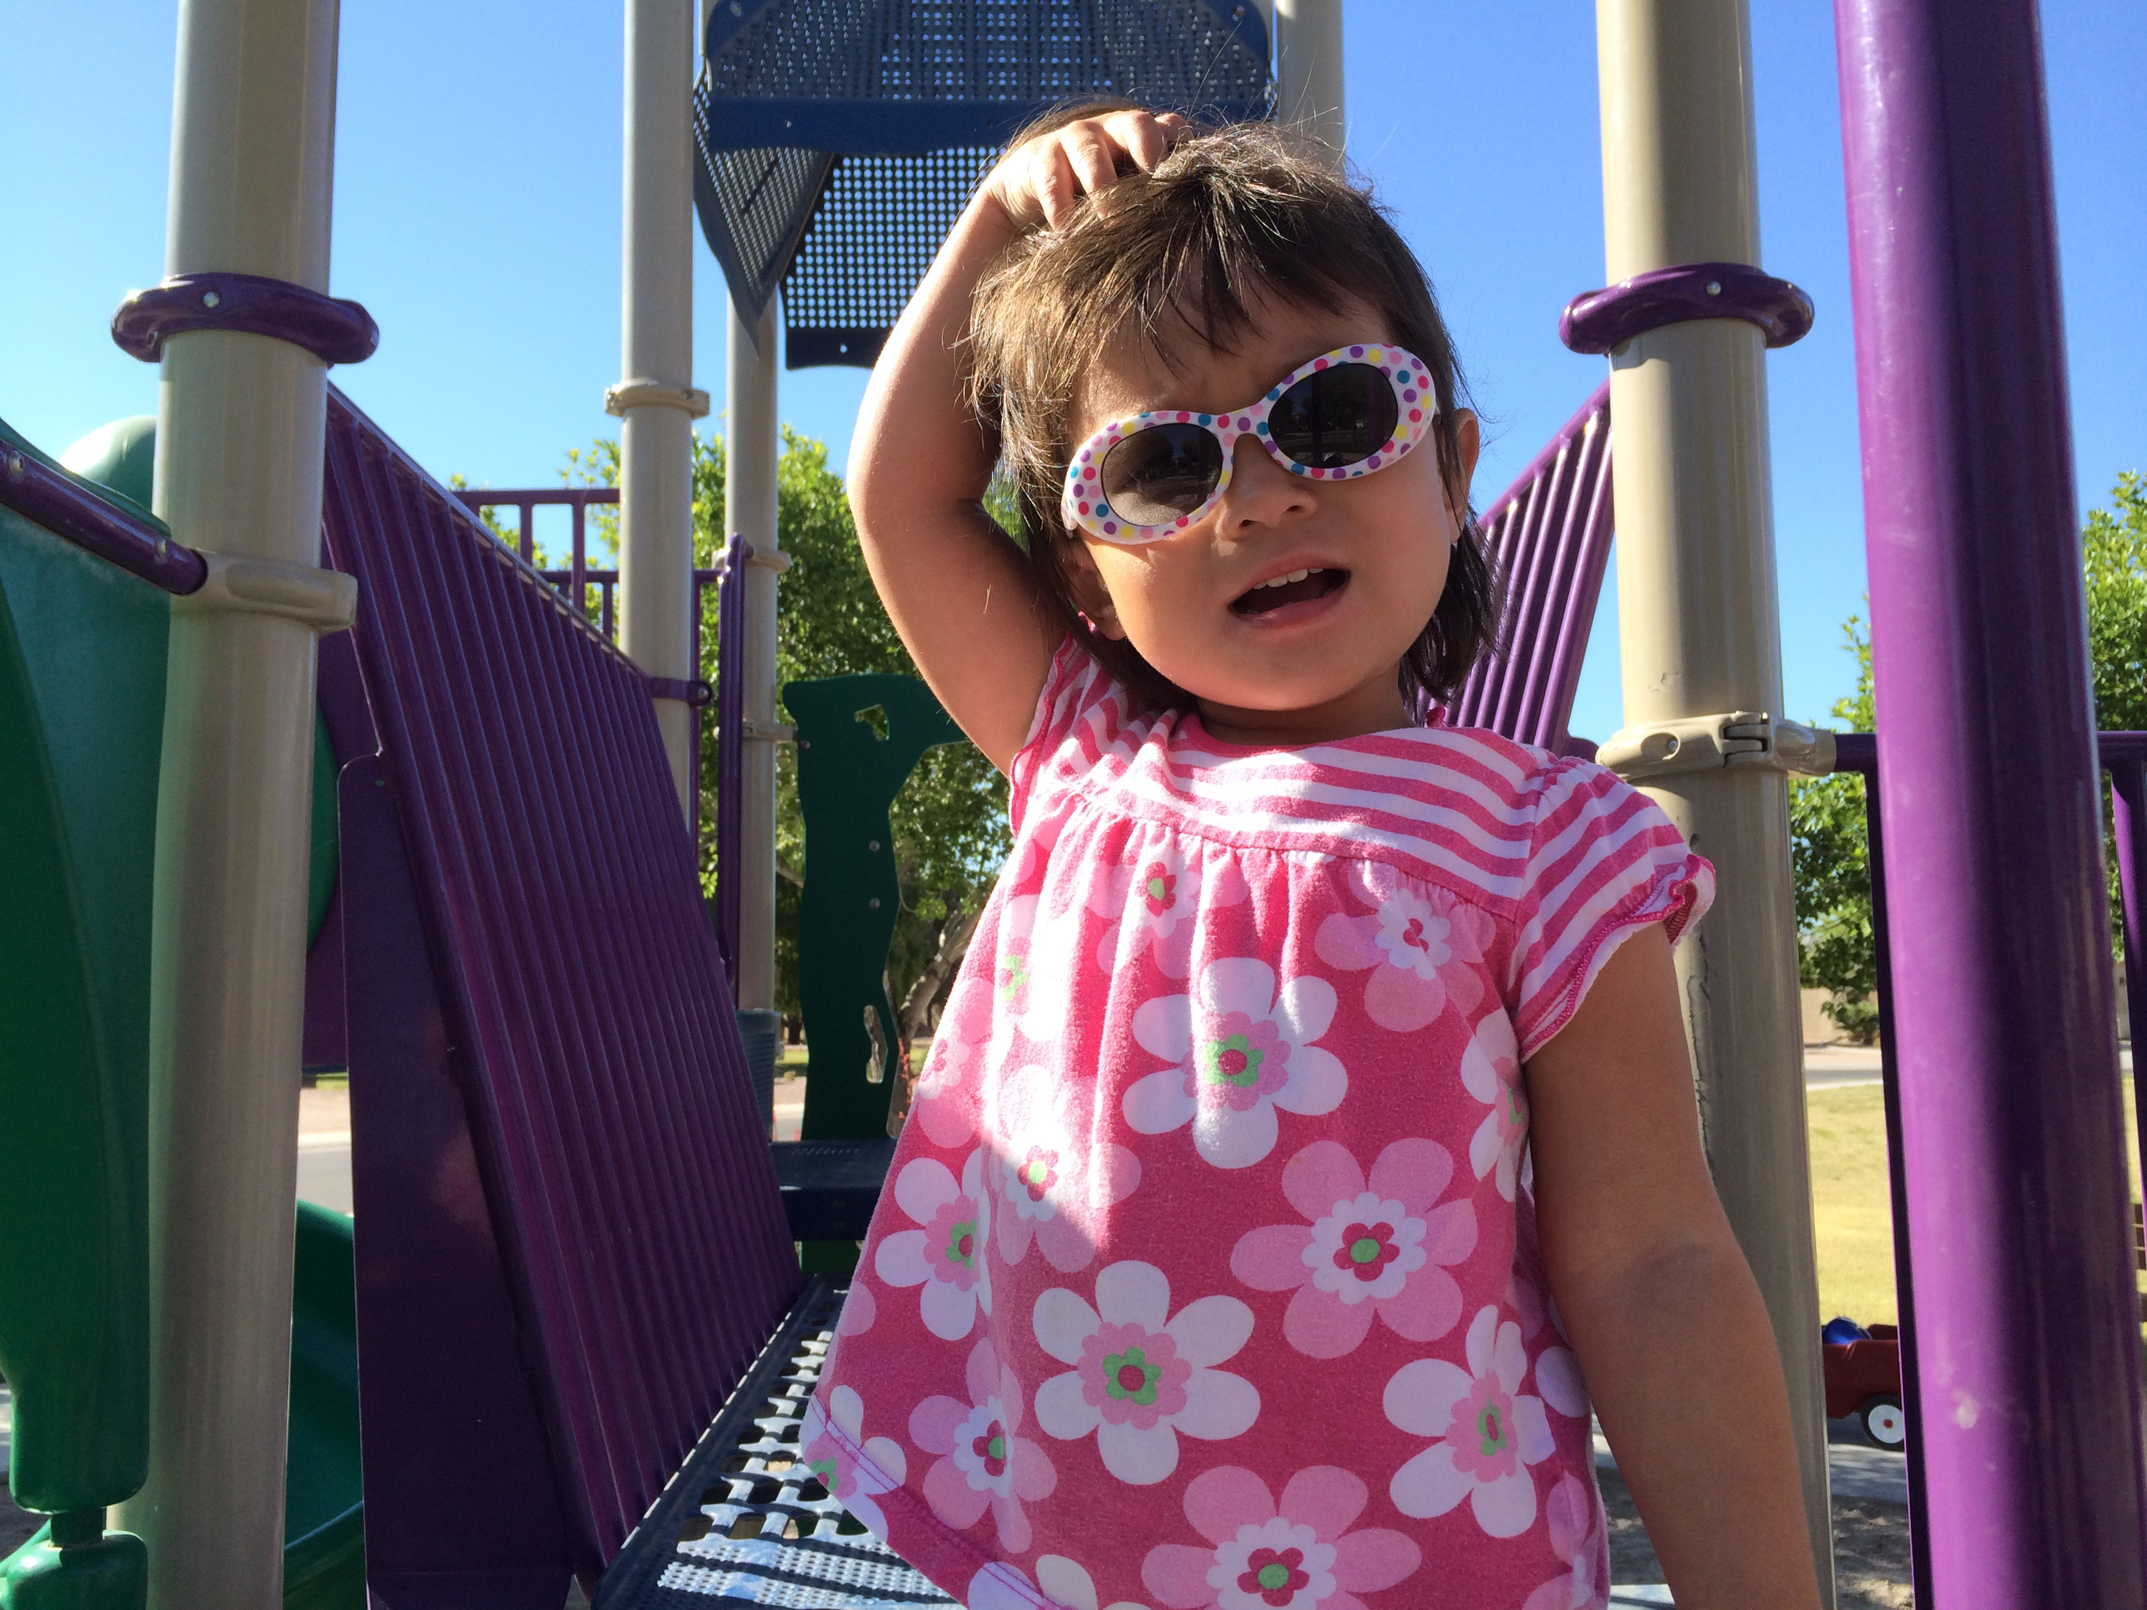
Questions?
Thank You

Slide 40
www.cals.arizona.edu/apmc/public-health-IPM

